Slide 1
Detecting diseases in plants
By Bagus Satrio Wicaksono

Slide 2
Objective
The program can distinguish between healthy and diseased plants.
Farmers can benefit from being able to easily detect diseases in their crops.
Conducting plant checks using image processing.

Slide 3
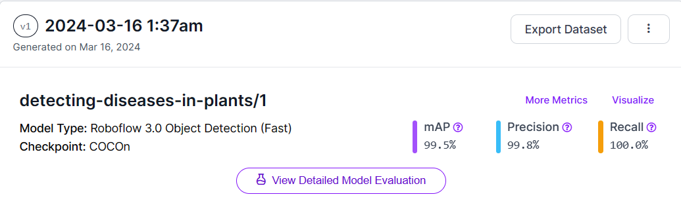
Information: from roboflow

Slide 4
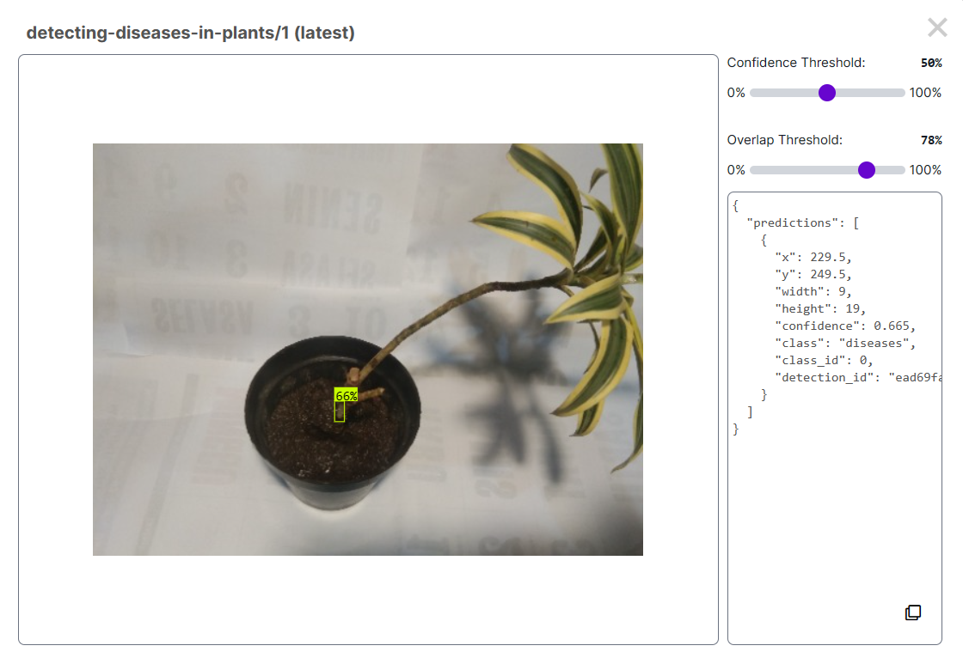
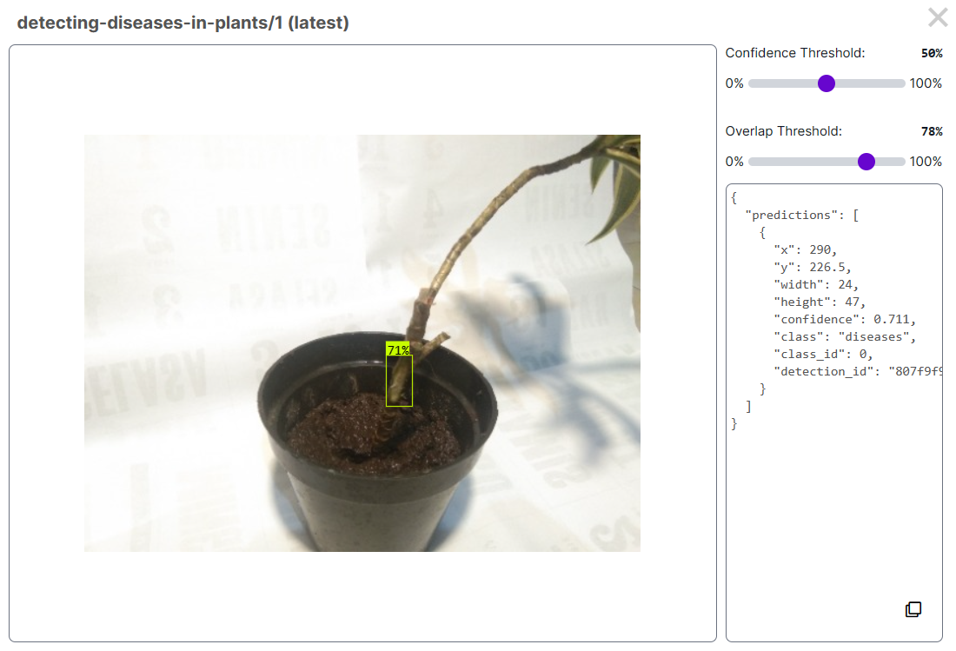
Trying Model

Slide 5
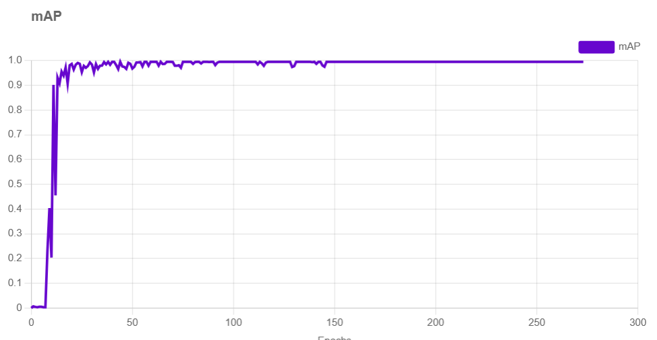
Data mAP

Slide 6
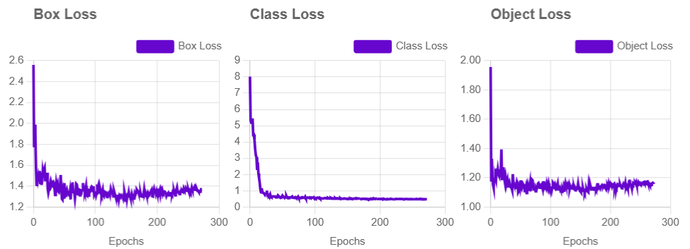
Data information loss

Slide 7
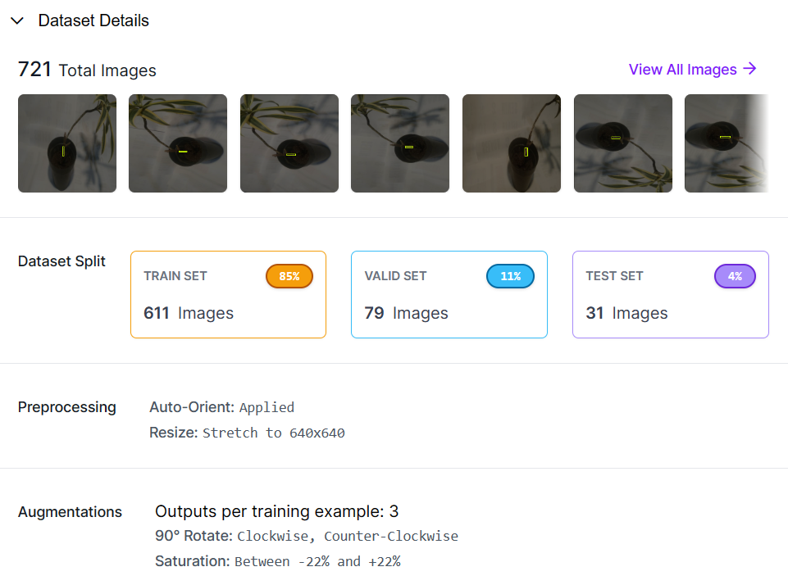
Data

Slide 8
Code
!pip install roboflow
from roboflow import Roboflow
rf = Roboflow(api_key="SukwphTauW89K42A4xPw")
project = rf.workspace("satss").project("detecting-diseases-in-plants")
version = project.version(1)
dataset = version.download("yolov9")

Slide 9

Try program on mobile

Slide 10
Result
The object detection is running smoothly; the program can identify the location of diseases in plants.
The results I provided were obtained from Roboflow, as there are still errors in developing the program.

Slide 11
Thank You

